Slide 1
Classification and Detection of Autism Spectrum Disorder Based on Deep Learning Algorithms
Hindawi
Computational Intelligence and Neuroscience
Volume 2022, Article ID 8709145, 10 pages

Slide 2
Introduction
The paper examines AI's role in early ASD detection, focusing on techniques like facial recognition and deep learning.
Using pretrained models, the authors detect ASD from children's images, with the Xception model performing best.
They also introduce a system for ASD detection via eye and face identification. Overall, the paper highlights AI's importance in ASD diagnosis and presents a novel deep learning approach for detection.

Slide 3
Materials and Methods
Dataset :
2940 children images evenly split between autistic and non autistic.
(1470 Autistic , 1470 Non Autistic)
Source : Images were collected from various internet sources including websites and facebook pages related to autism.

Slide 4
Preprocessing :
The data preprocessing aimed to clean and crop the images collected from internet sources.
After automatic face cropping, the dataset was split into :
Normalization rescaled pixel values from [0, 255] to [0, 1].
2,540 training images | 100 validation images | 300 testing images

Slide 5
Convolutional Neural Network Models:
Convolutional Neural Network (CNN) models play a crucial role in medical applications, particularly in disease detection and behavioral analysis, leveraging computer vision techniques.
Their advancement in AI aids in assisting humans, showcasing significant contributions to various aspects of healthcare.

Slide 6
Basic Components of the CNN Model :
The Convolutional Neural Network (CNN) is a well-known type of deep learning algorithm used for tasks like image recognition.
It processes images by assigning importance to different parts of the image to classify it.
Neurons in CNNs mimic the communication patterns of biological neurons.

Slide 7
Convolutional Layer with a Pooling Layer :
The convolutional layer in the CNN model takes input images represented as pixel values and aims to simplify them without losing important details for autism detection.
It focuses on extracting basic features like edges and colors.
To handle the large number of parameters, it uses either max pooling or average pooling, which reduces the weights.
This process involves the kernel's window moving across the image, extracting features and reducing parameters through pooling.

Slide 8
Fully connected layer and activation function :
The fully connected (FC) layer combines high-level features from hidden layers to produce outputs.
It treats the input image as a column vector.
Training involves forward propagation, where flattened output feeds into the neural network, and backpropagation, where the network minimizes loss errors and learns more features over iterations.
Increasing hidden layers and training iterations enhances performance by allowing deep extraction of low-level features.
The softmax classifier, utilizing parameters from the FC layer, predicts outputs; a softmax output of 0 indicates class 0 (autism), while 1 signifies class 1 (normal).

Slide 9
Deep Learning Models :
The research focuses on three pre-trained
These 3 models exploit features from facial images to detect autism.
Xception | VGG19 | NASNetMobile

Slide 10
Xception model :
The Xception model, trained on ImageNet for image recognition, employs inception layers composed of depthwise and pointwise convolutions.
In this study, feature extraction involves using pretrained models to extract features from the dataset and adding custom top layers for classification.
Fine-tuning adapts generic features to specific classes.
The architecture includes dense layers with ReLU activation, followed by global max pooling, batch normalization to prevent overfitting, and RMSprop optimizer for parameter training, with Softmax used for output prediction.

Slide 11
VGG19 :
VGG19, a deep neural network model with 19 layers, is based on CNN techniques and commonly utilized with the ImageNet dataset.
Its uses 3x3 convolutional layers and max pooling layers to reduce input volume size.
The model comprises two fully connected (FC) layers with 4,096 neurons each to connect different layers.
The input layer accepts images sized 224x224 with three color channels , while convolutional layers maintain the image size by moving one pixel at a time during processing.
ReLU is used instead of Local Response Normalization in hidden layers to save memory and training time without boosting accuracy.

Slide 12
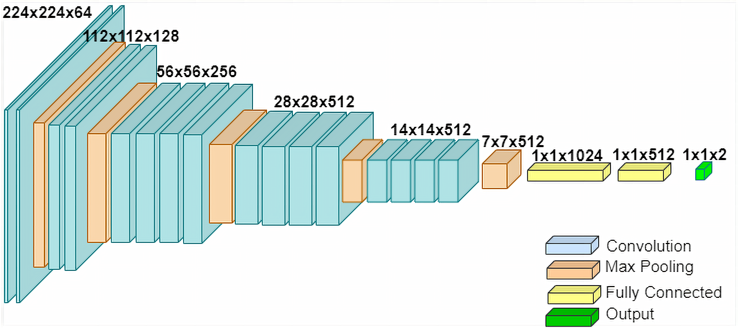

Slide 13
Experiments
Experimental Setup :
Hardware :
Software/libraries :
TensorFlow library / Keras library / Panda seaborn / Matplotlib / Numpy.
Processor core I7 | 8 GB RAM

Slide 14
Parameters used in the pretrained deep learning models :
Global max pooling layer size : 3 ∗ 3
Dense layer : 128, 64
Batch size : 32
Number of epochs : 100
Output classification layer : Softmax
Optimizer : ADAM
Activation function : Rule

Slide 15
Experimental Setup :
The study employs performance evaluation metrics including accuracy, sensitivity, specificity, and a confusion matrix for the three pretrained models. A confusion matrix provides a summary of true and false classification results. (True positive, True negative , False positive, False Negative)
Diagonal of the matrix represents the correct classifications.
Specificity is the capacity of the model to correctly identify the normal children.
Sensitivity is the capacity of the model to correctly identify autistic children.

Slide 16
Results and discussion
Despite variations in age and image quality within the dataset sourced from the internet, the Xception model performed the highest with 91% accuracy.
Model name | Specificity | Sensitivity | Accuracy
Xception | 0.94 | 0.88 | 0.91
VGG19 | 0.83 | 0.78 | 0.80
NASNETMobile | 0.75 | 0.82 | 0.78

Slide 17
Conclusion
Interest in child autism has increased with advancements in global health, driving efforts to detect and understand the condition early. This study assessed three deep learning models—NASNETMobile, Xception, and VGG19—for ASD detection using facial features. The Xception model achieved the highest accuracy at 91%, showcasing its potential as a valuable tool for swift and accurate autism diagnosis.

